Slide 1


Slide 2


Slide 3
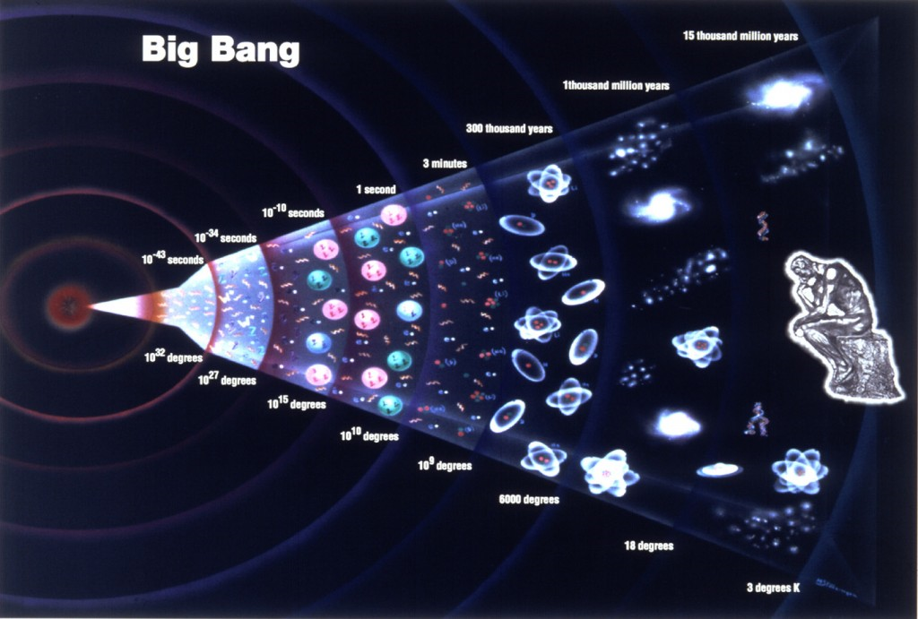

Slide 4

Stasis Entropy Chaos

Slide 5

STASIS

Slide 6

ENTROPHY

Slide 7
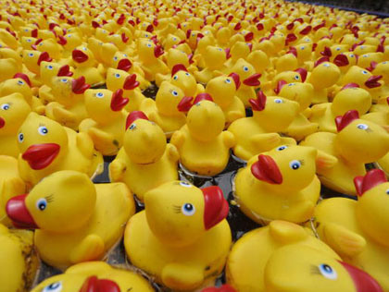
CHAOS

Slide 8

The Imploding Universe

Slide 9

ALWAYS A DESIRE TO RETURN TO STASIS

Slide 10
8 Steps to Settlement
Compromise is a process that takes TIME to work.

Slide 11
Common Perceptions and Misperceptions about mediation

Slide 12
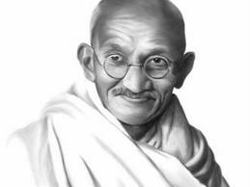

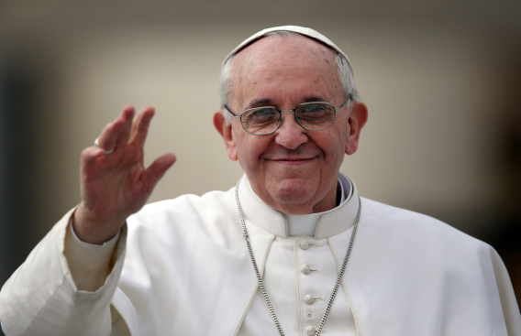
The Mediator as a WISE PEACEMAKER

Slide 13


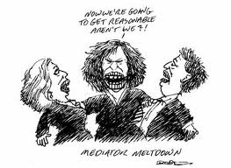


Slide 14


The Parties as Irrational and Crazy

Slide 15



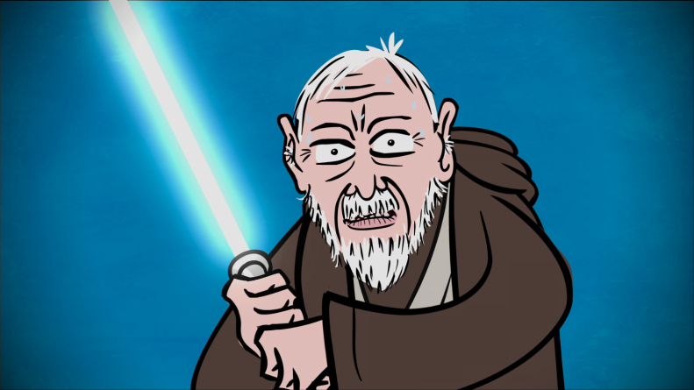
The Representatives as Warriors

Slide 16




Subjective – Emotional
Objective

Slide 17


The problem of PHANTOMS
Phantom Decision-Makers
Phantom Decision- Influencers

Slide 20
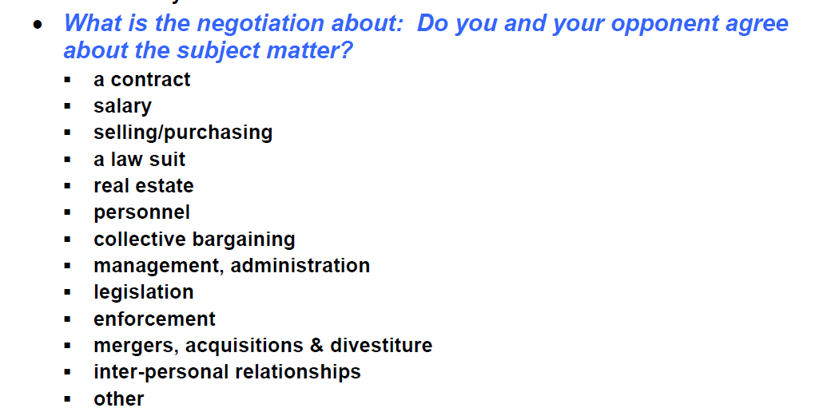

Slide 32

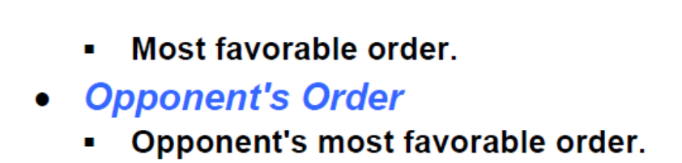

Slide 33
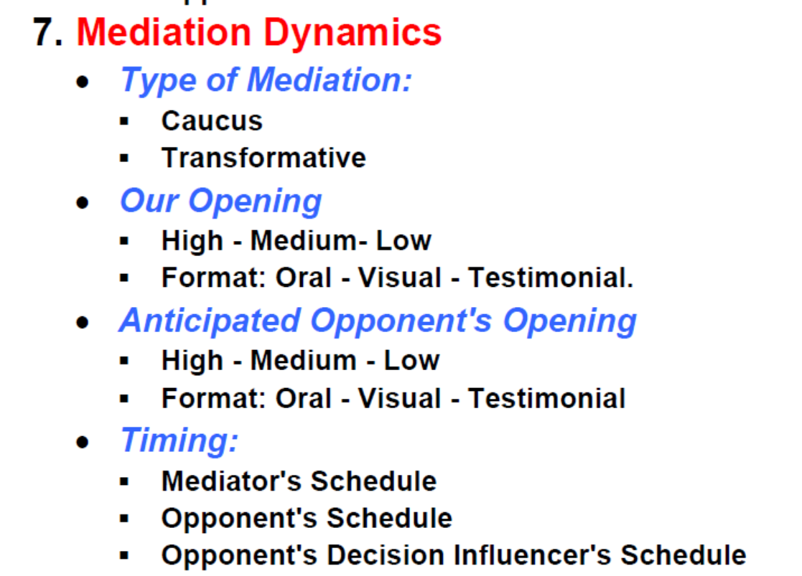

Slide 35

Nick Critelli
www.CritelliLaw.com
Nick@CritelliLaw.com
NCritelli@CritelliLaw.co.uk

